Slide 1
Session #6
CLC 12
Focus: researching financial awards and dealing with early admissions season.
Whatever future path you are considering, there will be financial realities to deal with unless you’re already independently wealthy, in which case congratulations.
Session 5 gave you an idea of some of the tuition costs for three possible paths you may want to follow, but that’s only a part of the picture.
Many scholarship and bursary deadlines are coming up as your grad year progresses. There are often announcements in the Newsbreaker. Detailed information on many of these financial awards is available in the library filing cabinet.
You should be aware that many of these financial awards can also be explored on the school website. Hopefully, you already know this.
There are well over a hundred financial awards that are given to a very diverse range of students. Not all are based on academics. For some awards, it may just depend on what elementary school you attended, or the trade/occupation path you intend to follow. Be aware that many of these awards have gone unclaimed in the past, or they have had only one or two people apply for them.

Slide 2
For the first part of Session 6, you should go to the Graduation menu for the FKSS website, and research financial awards that you could apply for.
There is another “financial award” choice under the Graduation menu for U.V.I.C specifically.
If your future plans seem clear already, it’s worth checking out the websites of the institutions you want to attend. In many cases, they will have their own set of financial awards for specific programs.
❊This is the time of year many institutions give you an opportunity for early admission. If you’ve narrowed your choices down to three, or fewer, options that you are serious about applying for, then you can also use this session to look into the early admission process.
Most institutions should have this clearly set-up on their websites. Setting this up can allow you to begin organizing campus housing etc.
Getting the early admission process started may be critically important for some students. If this is not the case for you, it is best to explore the district scholarships/bursaries for now.

Slide 3
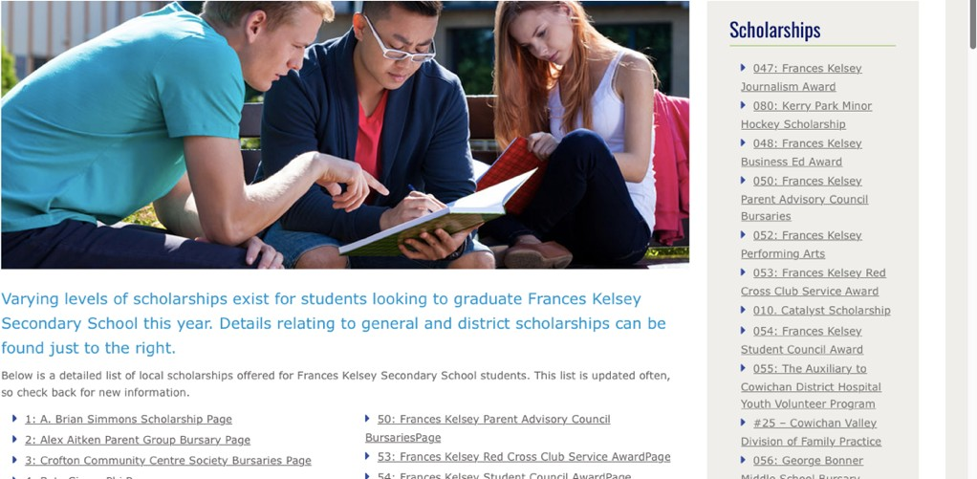
Here is an example of adding a link to your Scholarship and Bursary portfolio in MyBlueprint (ideally, you already created this portfolio for yourself in Session 1). This will allow you to quickly refer to it later when you start applying for it.
After going to the Graduation menu at the FKSS site, look over the list of possible awards. Unfortunately, the only way to truly find out if it’s a possibility for you is to select it and take some time to read over the details. Look at the application form as well.
Before you give-up, try to think about it this way: Even if it took you four hours to research, and apply, for three different awards and you got only one award for $500 that would be ~ $125 per hour for your efforts.

Slide 4
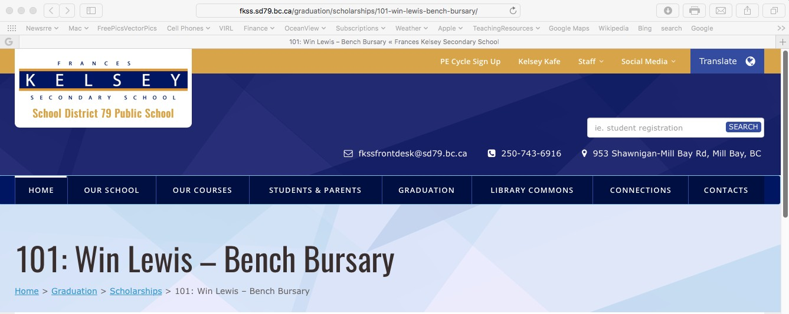
Try to find at least three possibilities for yourself. As you find each one, copy the URL as shown below.
You can add this link to your Scholarship and Bursary portfolio in a variety of ways. Here is just one example.
If you already have a browser window, or tab, with your MyBlueprint account open, and you go to the Portfolios section, then select the Scholarship and Bursary portfolio … SEE NEXT PAGE

Slide 5
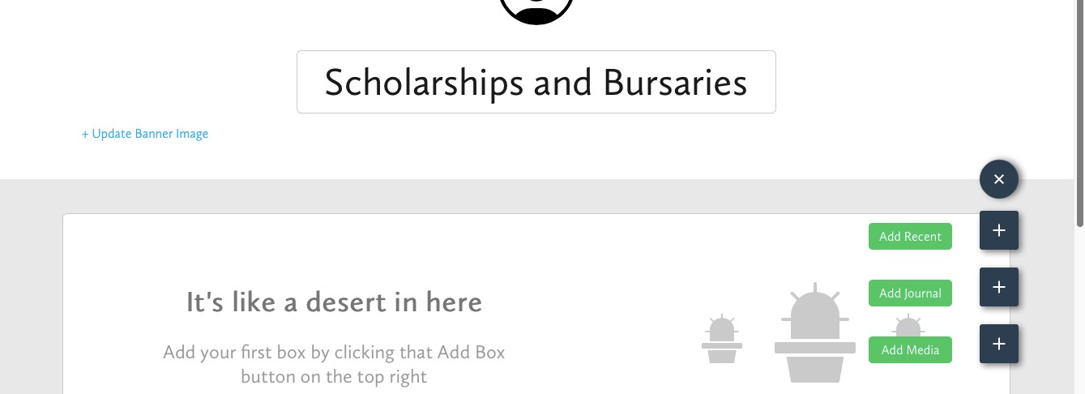
then select Add Box…
Select Add Media,

Slide 6
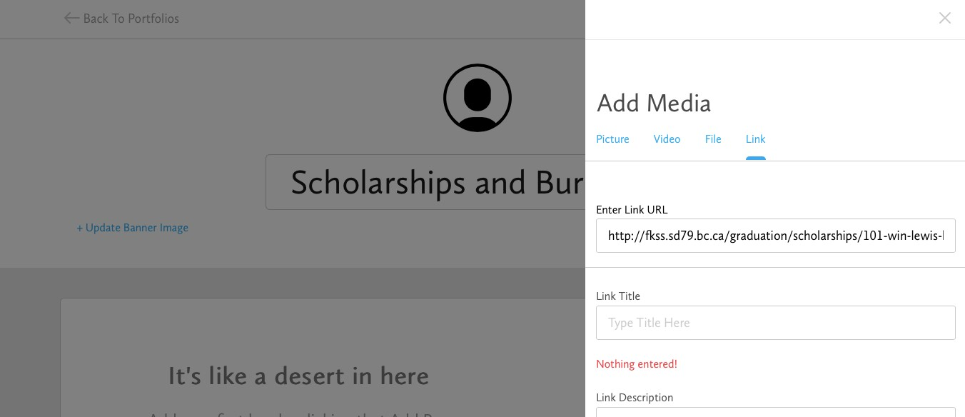
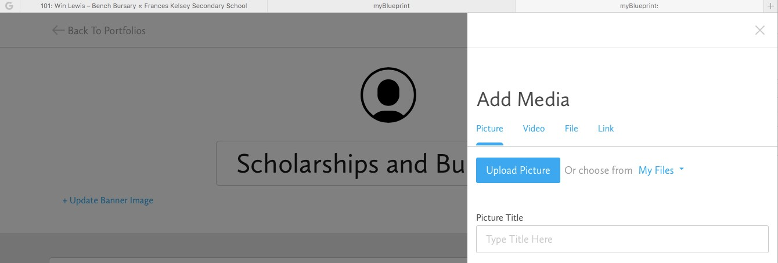
Choose Link.
Paste in the URL. It wants you to give it a title before you can save this to the portfolio for later consideration.
Try to do this for at least three serious possibilities. Remember, you could end up making more than $ 125 per hour for your efforts.

Slide 7
When the next session comes along, we’ll try to get into some of the other financial realities that you may face in the near future. At least you’ll be a little better aware of the financial awards that could help you a bit or a lot.
Remember to check out the prize draw section of MyBlueprint as well. As you have been completing things, you are also accumulating points that you can put towards upcoming prize draws for: ipads, Amazon gift cards, and Cineplex for example.
Complete the reflections section on the last page, and hand it in to your CLC 12 teacher.
To get the e-copy of Session 6 Reflection see next page.

Slide 8
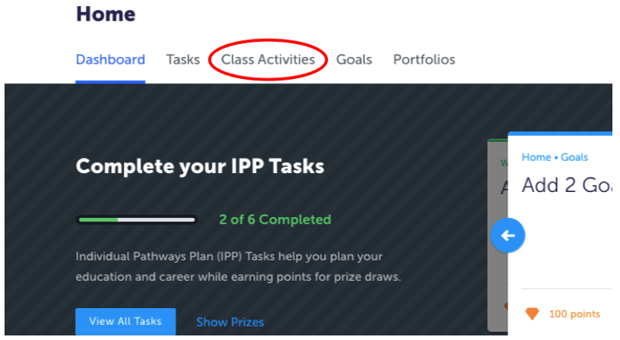
Navigate to your Home page…Click Class Activities to see the document “Session 6 Reflection”
Before typing in your details, go under File and click “Save As” to personalize your copy.
Once you have completed the Reflection upload it to your Portfolio “Possible Scholarships and Bursaries”

