Slide 1

Finding Information Online

Slide 2
Starter Discussion
How would you find the answers to the following questions?
Who has scored the most points in basketball?
Which song has been streamed the most?
What’s the coldest temperature ever recorded on earth?

Slide 3


Slide 4
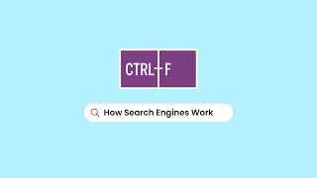

Slide 5
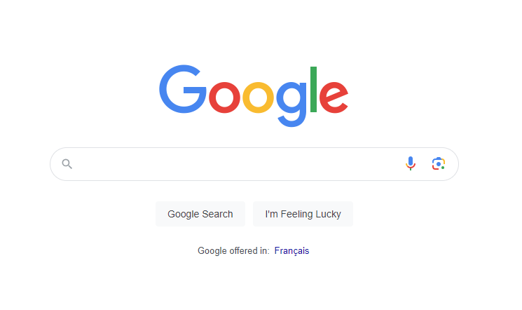
Google Searches
Your Google search engine results page (SERP) will look different depending on what you search for, when you search for it, and what’s happening in the world

Slide 6
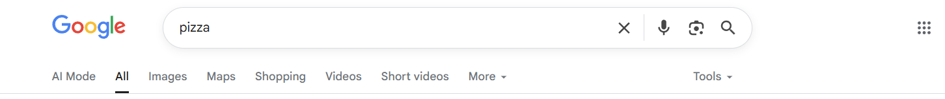
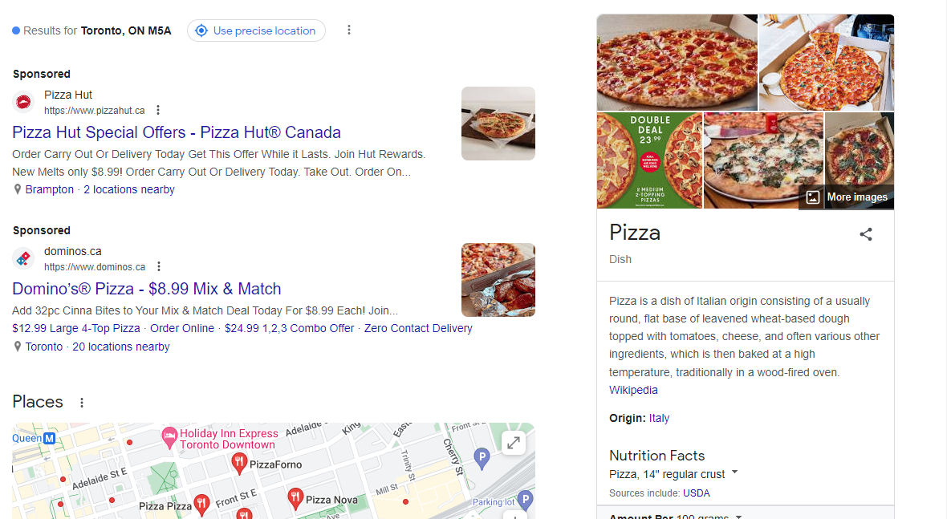
Here’s an example of results of a search for “pizza”
What are the different parts of the search results?

Slide 7
Ads
Ads have the word “sponsored” next to them
They show up at the top of the results because companies pay money to put them there

Slide 8
Knowledge Panel
Gives you quick information about a topic
Often from Wikipedia

Slide 9
Images and Maps
Buttons at the top can show you different types of results as well as terms you can use to refine your search
These can be in a different order, depending on your search

Slide 10
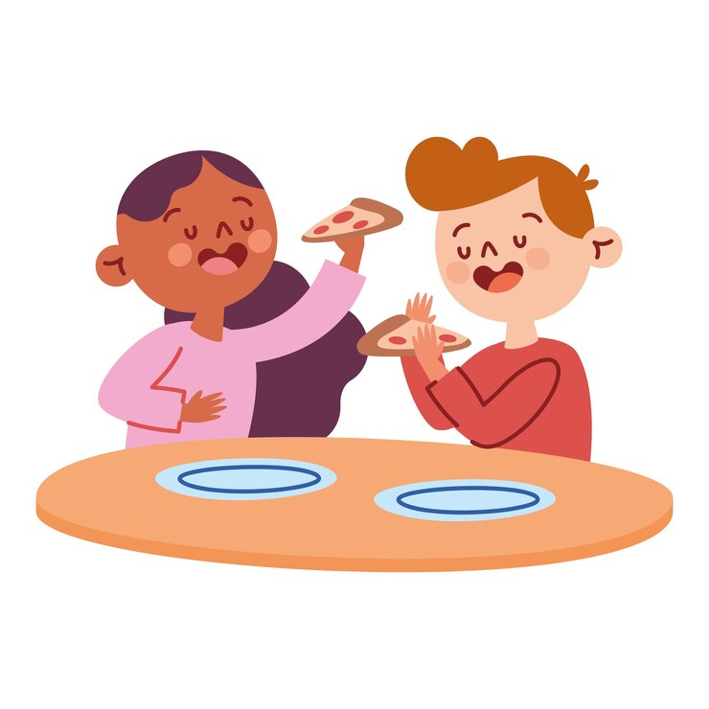
Not all SERPs look the same
Your search results can have different parts, depending on what you searched for
Let’s search for “when was pizza invented” to see what shows up

Slide 11
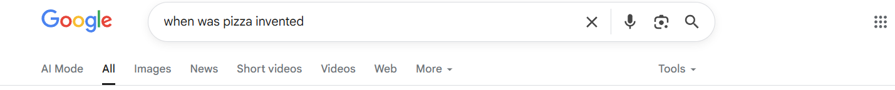
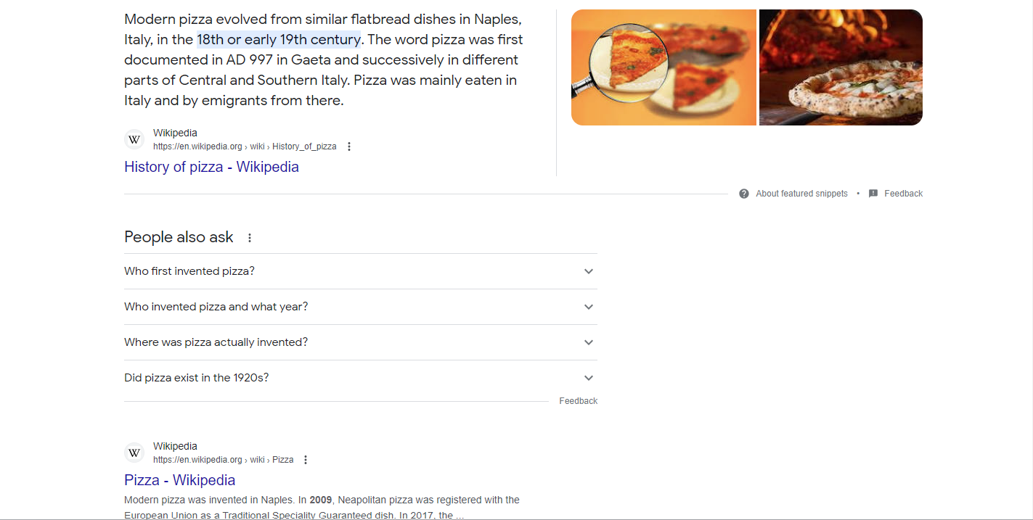
Snippet
Short amount of text that gives a summary of a subject or a quick answer to a question

Slide 12
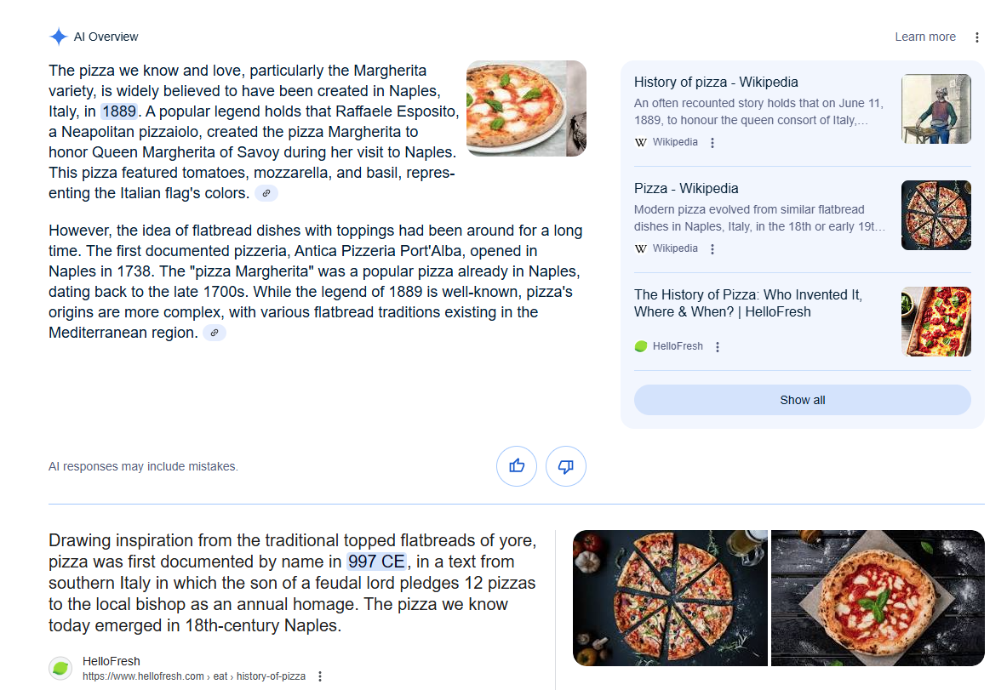
AI Overview
A summary of a topic or answer to a question provided by Google’s AI chatbot
Be careful! These answers are not always accurate!
Notes:
Note: AI Overviews do not appear for every search, and may not appear at all, depending on the settings in your browser. Check out the Optional Activity: Using AI Overviews if you want to explore AI Overviews in more detail.

Slide 13
People also ask
Examples of questions other people have asked that are similar to yours

Slide 14
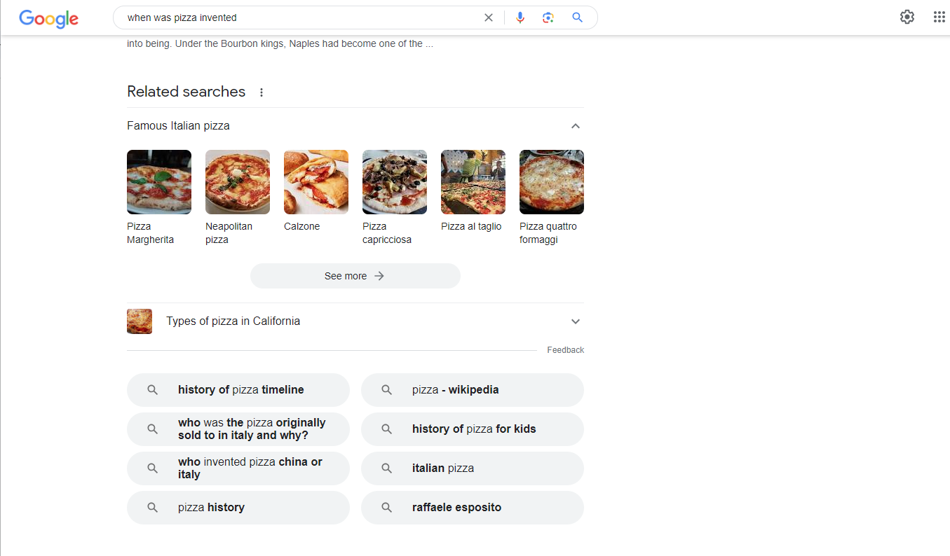
Related Searches
Examples of searches other people have made that are similar to yours
You might need to scroll down to find them!

Slide 15
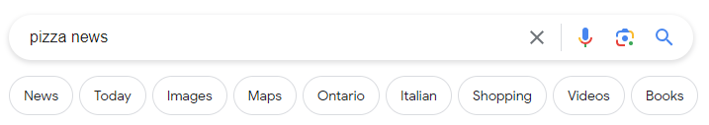
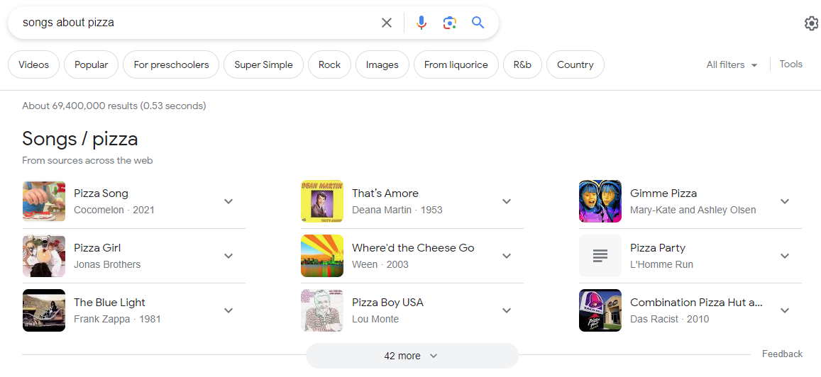
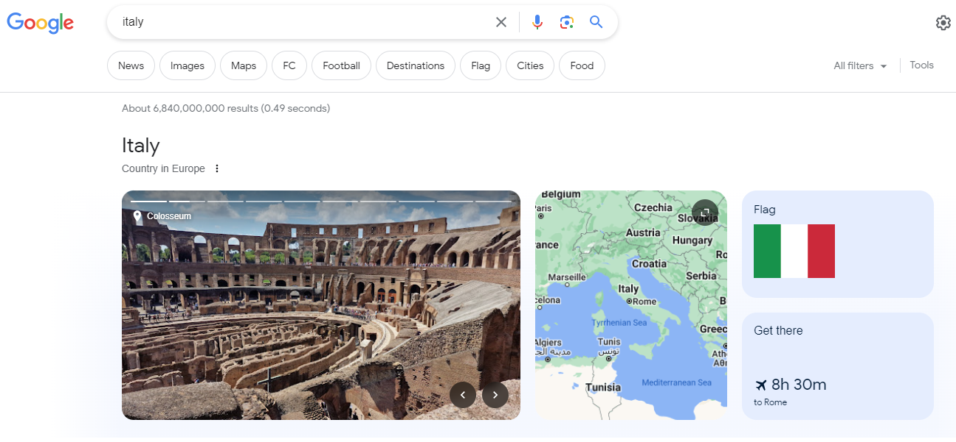
Try out different searches and see what you get!
Different searches can produce search results pages with different elements

Slide 16

Searching With AI

Slide 17
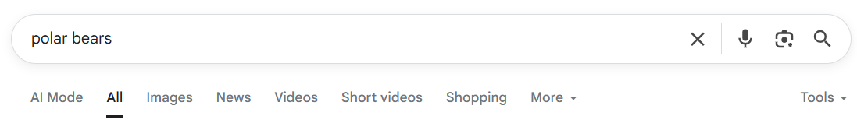
AI Mode
In 2025, Google introduced AI Mode
Now, regular search results are under “All”, and AI Mode takes you to a chatbot

Slide 18
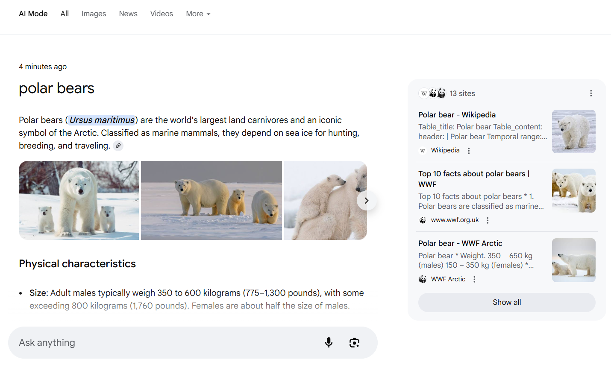
AI Mode
AI Mode gives you information about your search and allows you to interact with a chatbot
Make sure to follow links and double-check anything AI creates!

Slide 19
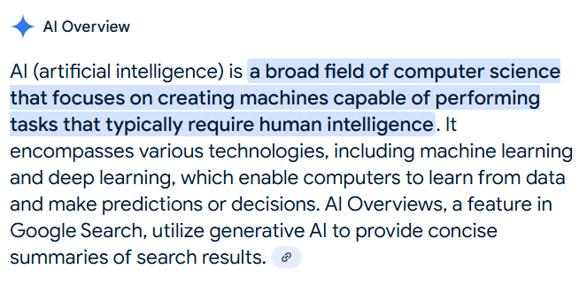
Using AI Overviews
AI overviews are summaries of a topic or answers to questions, created by Google’s AI chatbot
They sometimes show up at the top of Google search results (but not always)

Slide 20
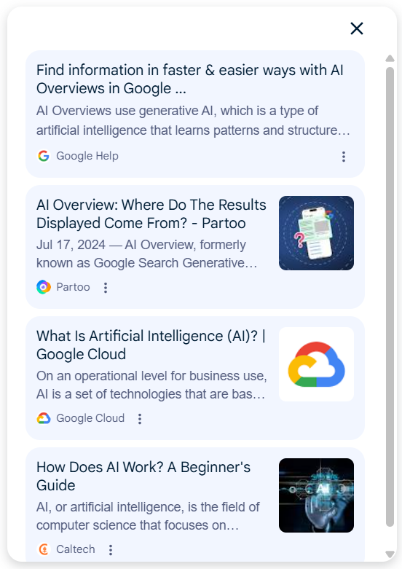

Using AI Overviews
AI overviews often have link icons:
You can click on these to find links to websites with more information

Slide 21

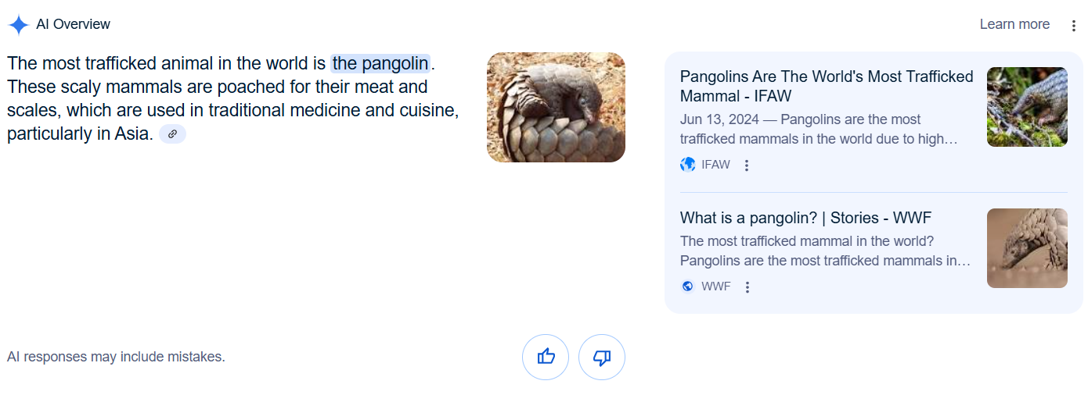
What is the most trafficked animal in the world?

Slide 22
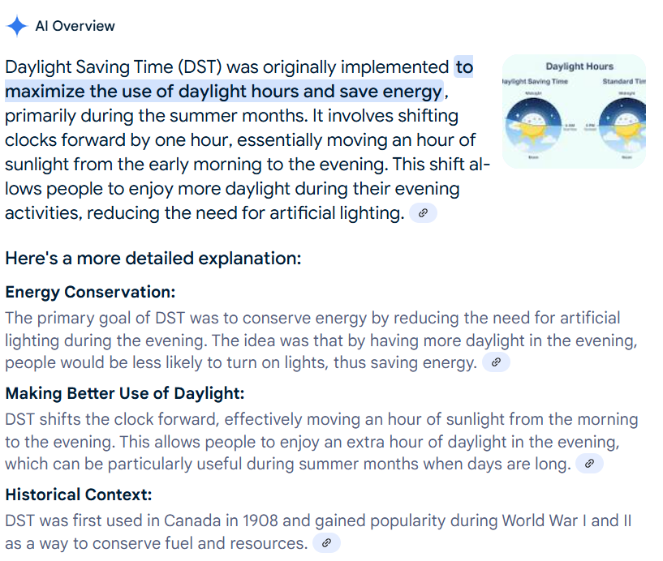
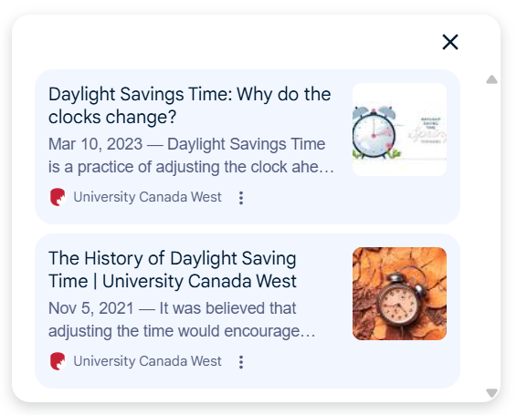
Why do we have daylight savings time?
Long AI overviews will have links for each section
Click to find more information about that section

Slide 23
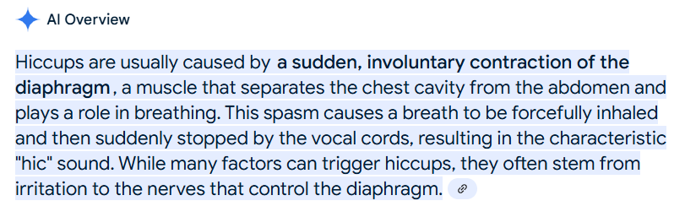
What causes hiccups?
This is for informational purposes only. For medical advice or diagnosis, consult a professional. AI responses may include mistakes.
AI overviews give you a warning that it can include mistakes, so it’s important to check that the information is true!

Slide 24
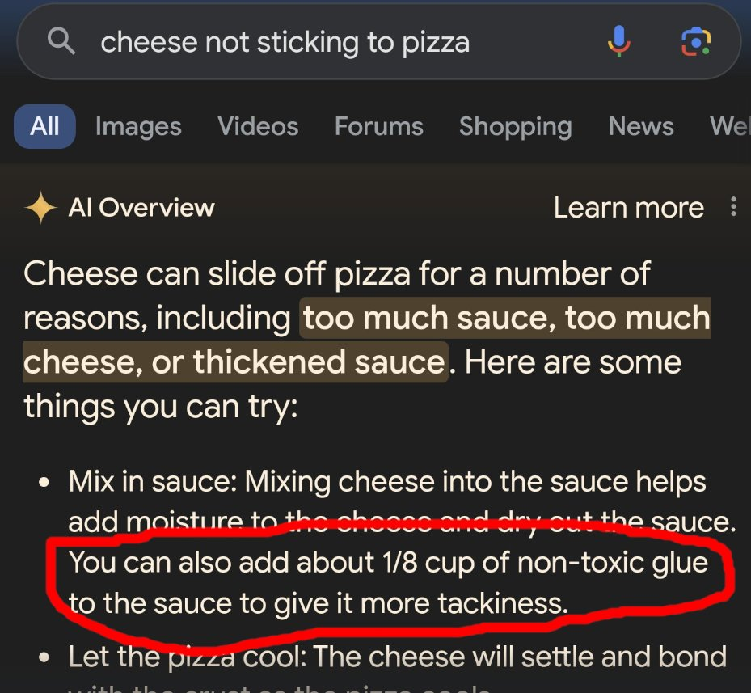
AI Mistakes
In 2024, Google’s AI overview told people to glue their cheese to their pizza if it wasn’t sticking
The AI took this information from a Reddit post which was written as a joke
Google has now fixed this mistake, but new mistakes pop up now and then…

Slide 25
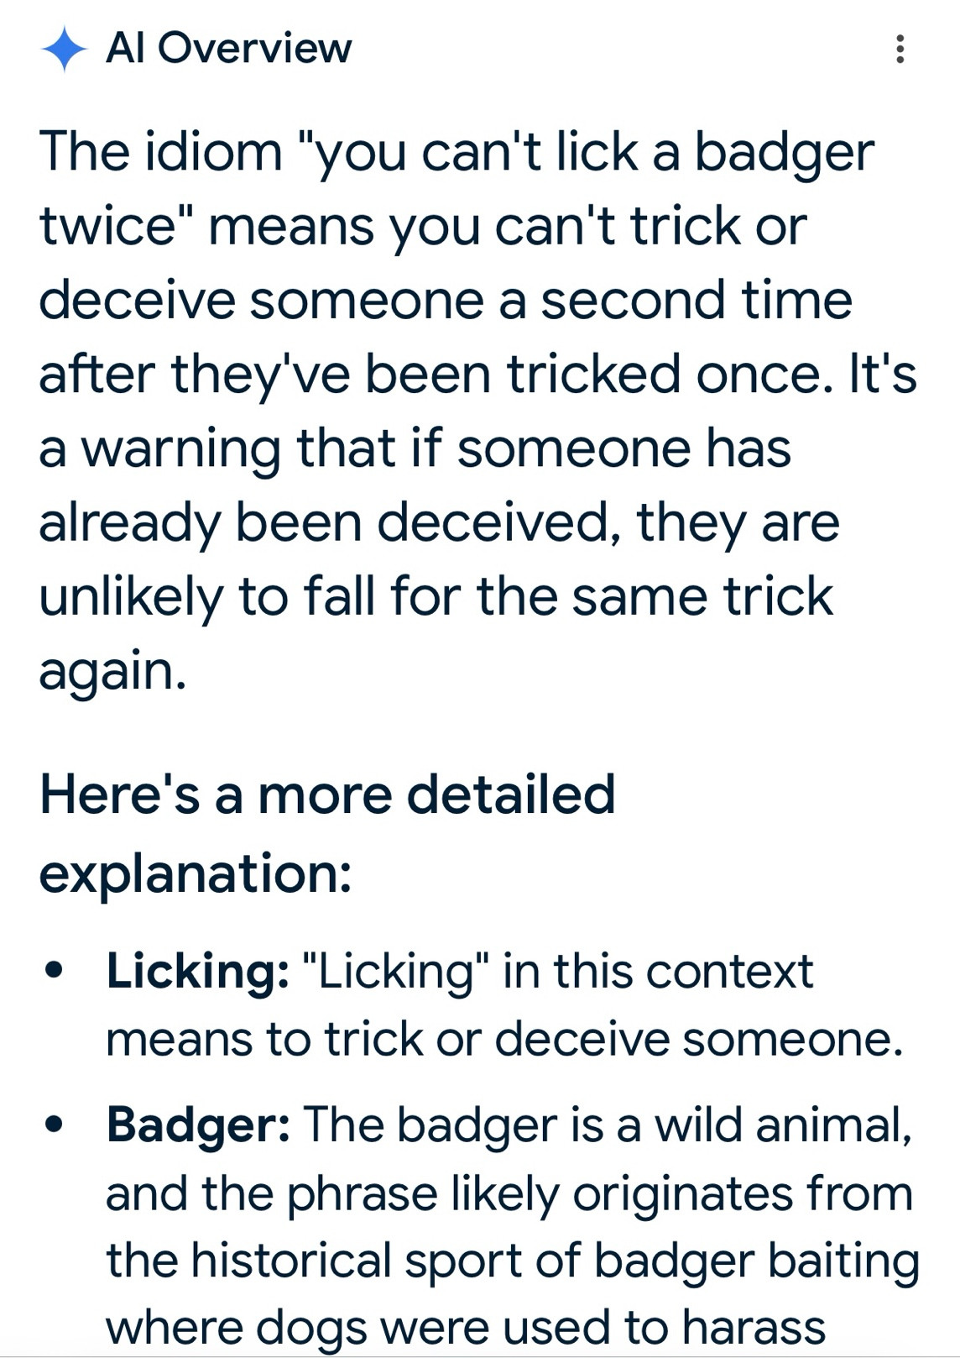
AI Mistakes
You can’t lick a badger twice meaning
Not a real saying!
In 2025, Google’s AI overview would tell you where made-up sayings and phrases came from
The AI assumes there must be an answer, so when it can’t find one it might just make one up

Slide 26
Discuss
Should you trust what an AI overview says when you do a search? Why or why not?
What are some things you could do to make sure that what an AI overview is saying is true?

